Slide 1
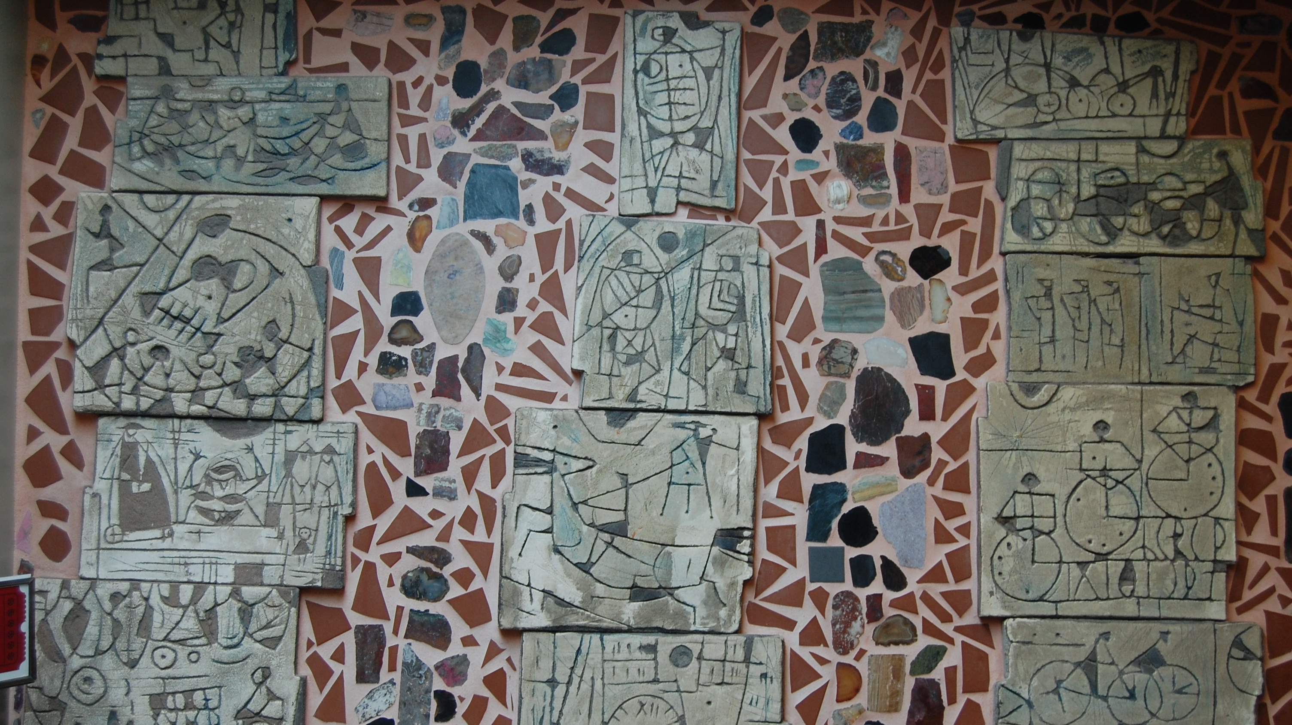
BAUHAUS INSPIRATION
The Architecture of the University of Victoria Gordon Head Campus
A physical documentation of the development of Modern Architecture in Victoria
October 2nd, 2021 Don W. Lovell

Slide 2
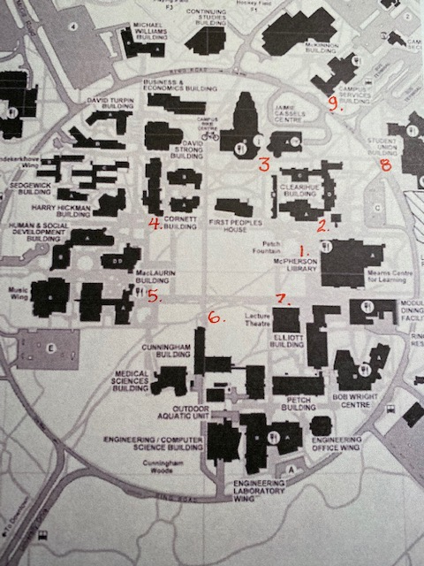
Campus Tour
Campus Master Plan
Wurster, Bernardi, & Emmons
1 McPherson Library
2 Clearihue A Wing
3 Jamie Cassels Centre
The Quad
4 Cornett Building
5 MacLaurin Building
6 Cunningham Building
7 Elliott Lecture Theatre
Optional tour
8 Student Union Building
9 Campus Services Building

Slide 3
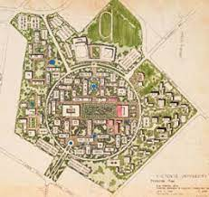
UVIC Gordon Head Masterplan
William Wurster & Donn Emmons 1961
Circular central campus
Large central Quad
610 metre diameter, walk in 10 minutes
Pedestrian zone
Liberal Arts to the North, Sciences to the South
Non-Academic buildings outside the Ring Road
Garden Campus, Buildings subservient to and linked by landscape
Buildings designed by local Architects, no one style
Campus buildings document the development of Modern Architecture in Victoria

Slide 4
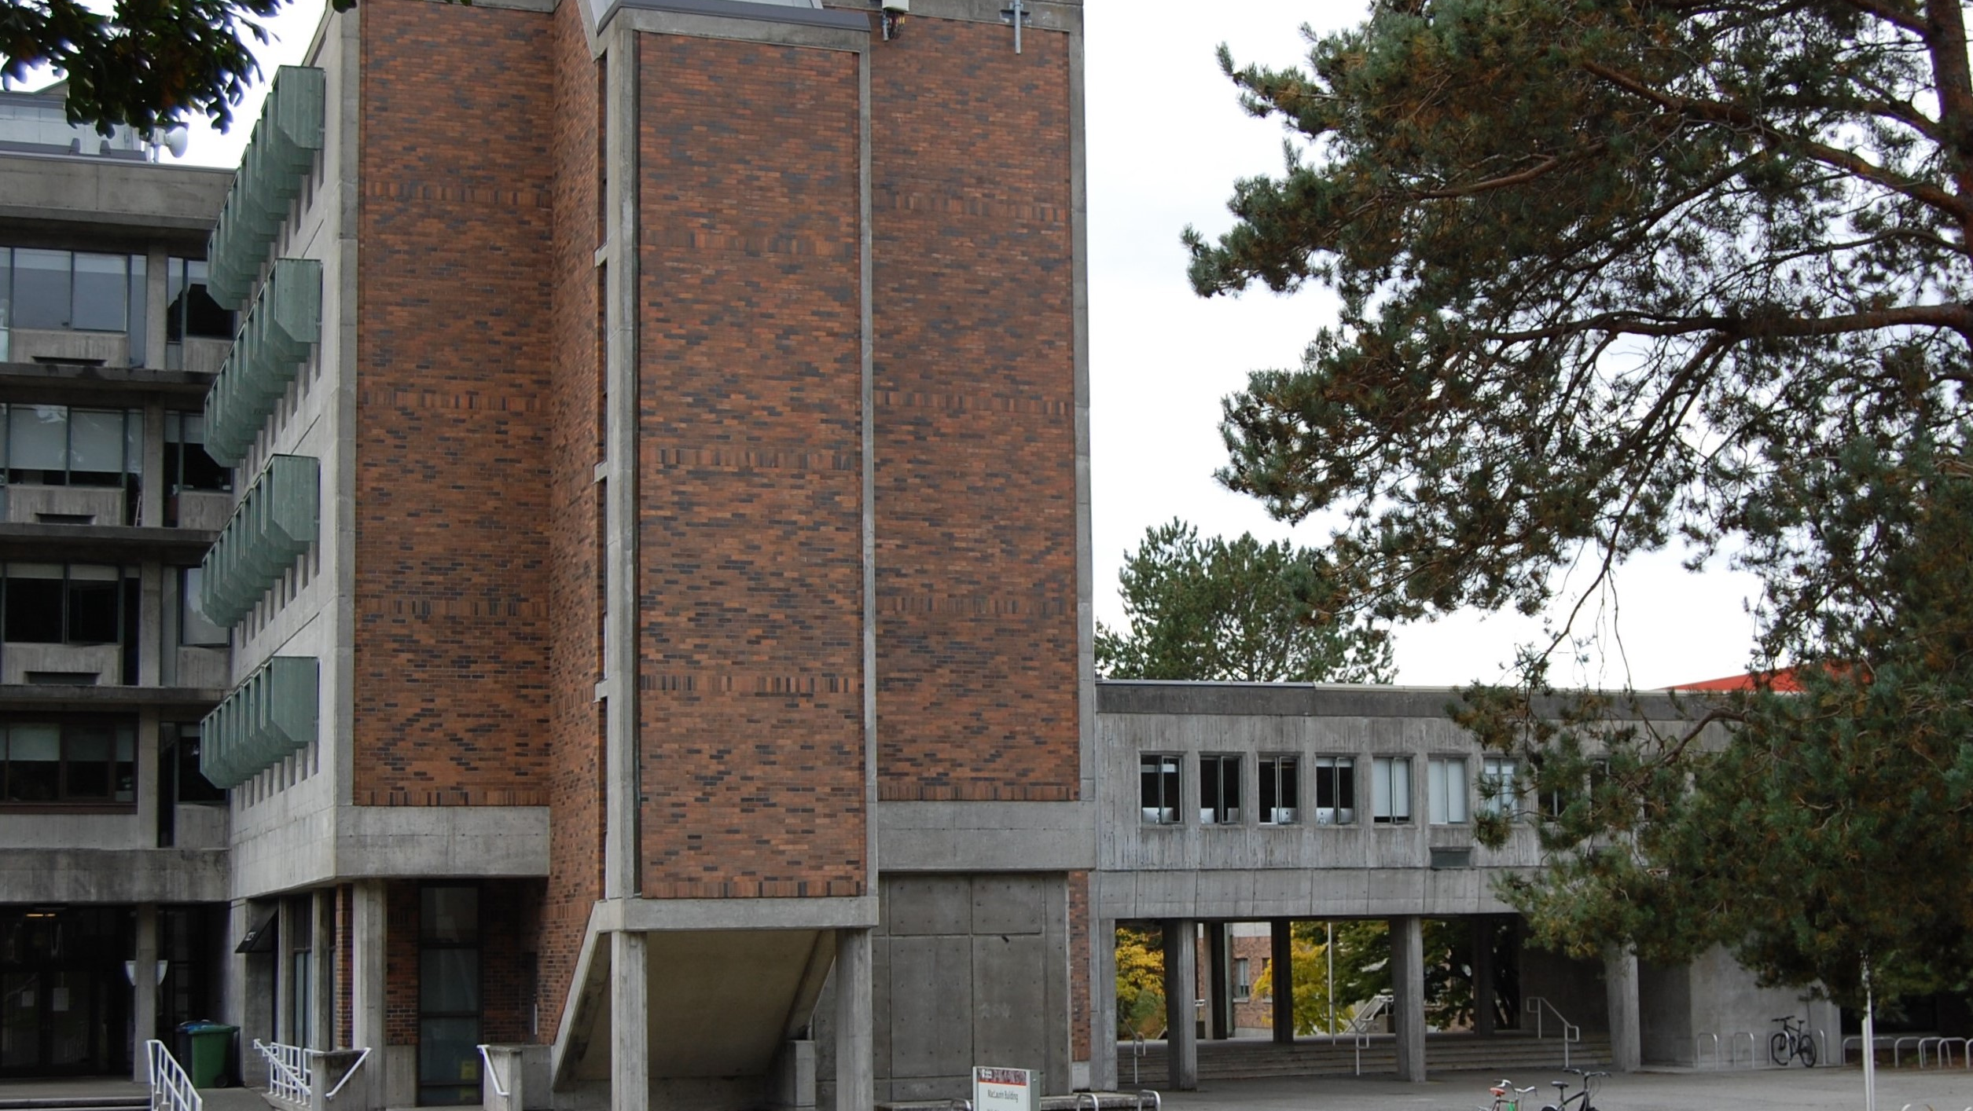
Bauhaus Influenced International Style
Functional Massing
Orthogonal Massing, straight line, right angles
Geometric shapes, no decorative elements
Structuralism & Material Expression
Brutalism
Critical Regionalism
Ribbon Windows
Pilotis / Pillars
Sunshades / Brise Soleil
Abstract art

Slide 5
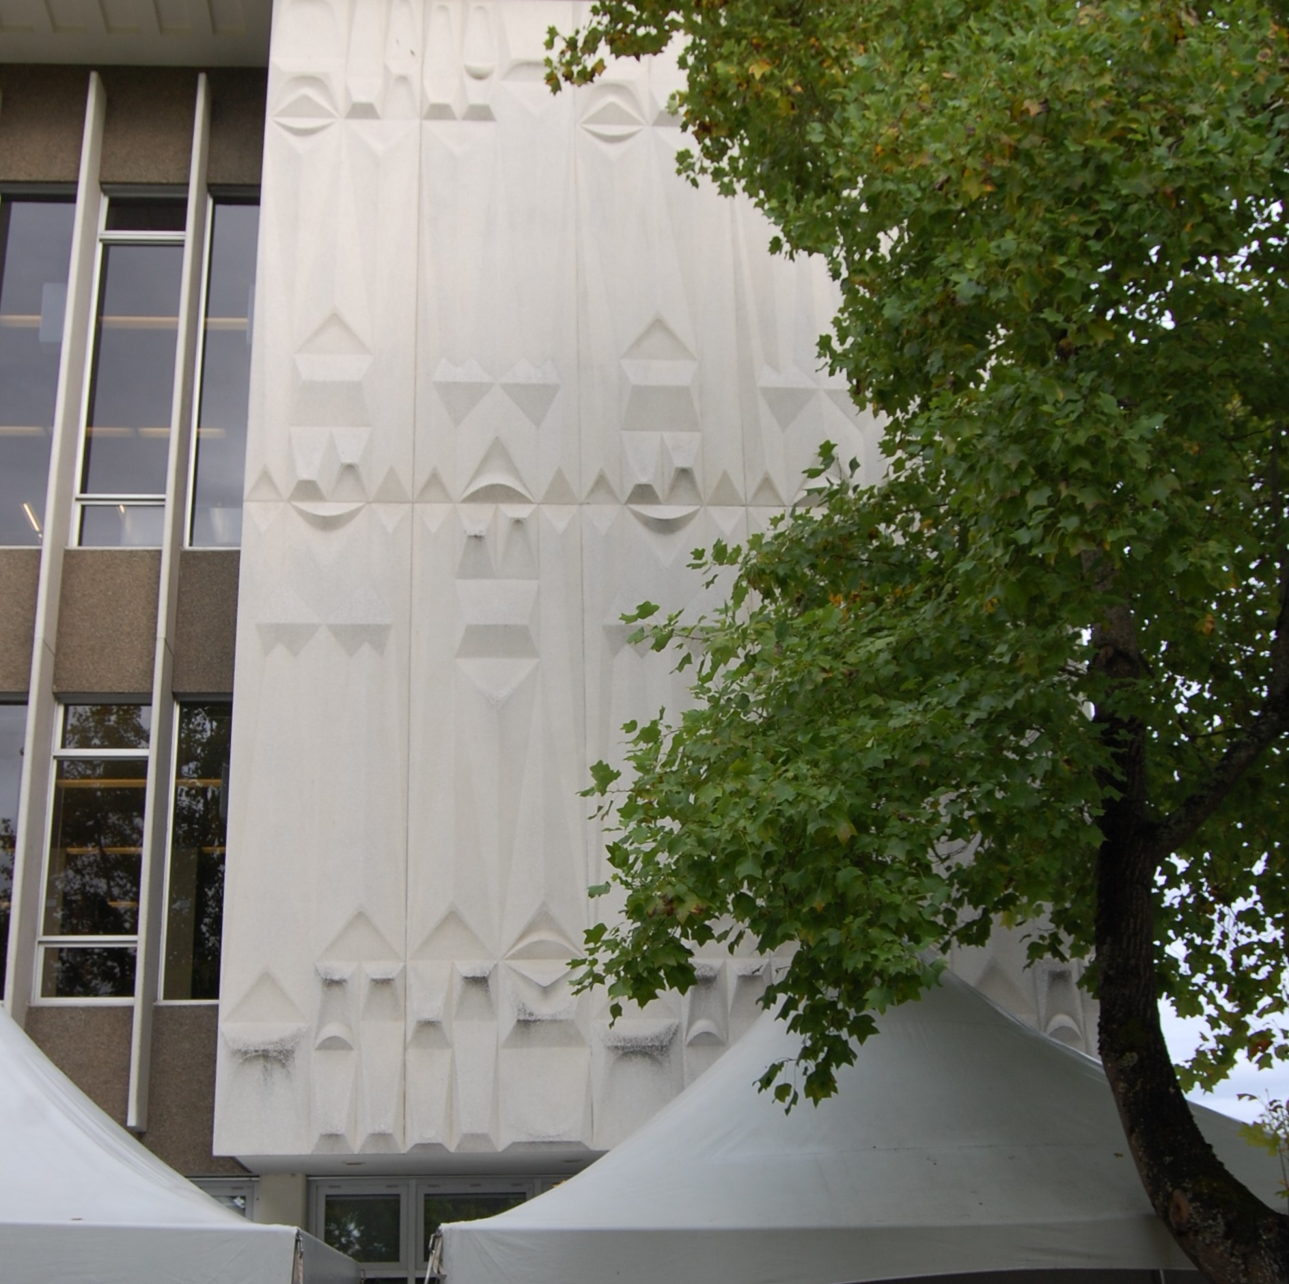
1. McPherson Library
1964
R.W. Siddall Associates
4 storey reinforced concrete
Exterior pre-cast concrete panels
Panels BC Sculptor George Norris

Slide 6
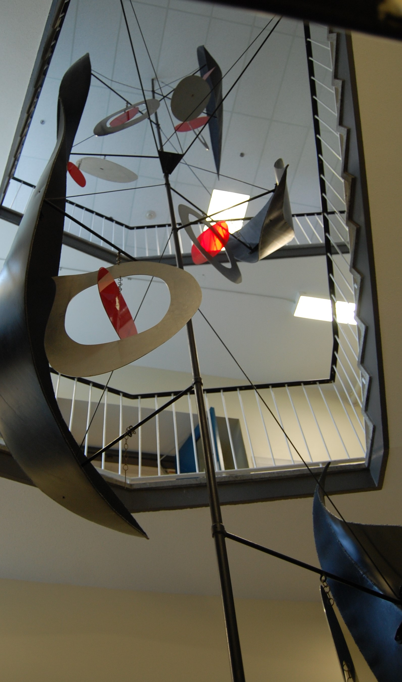
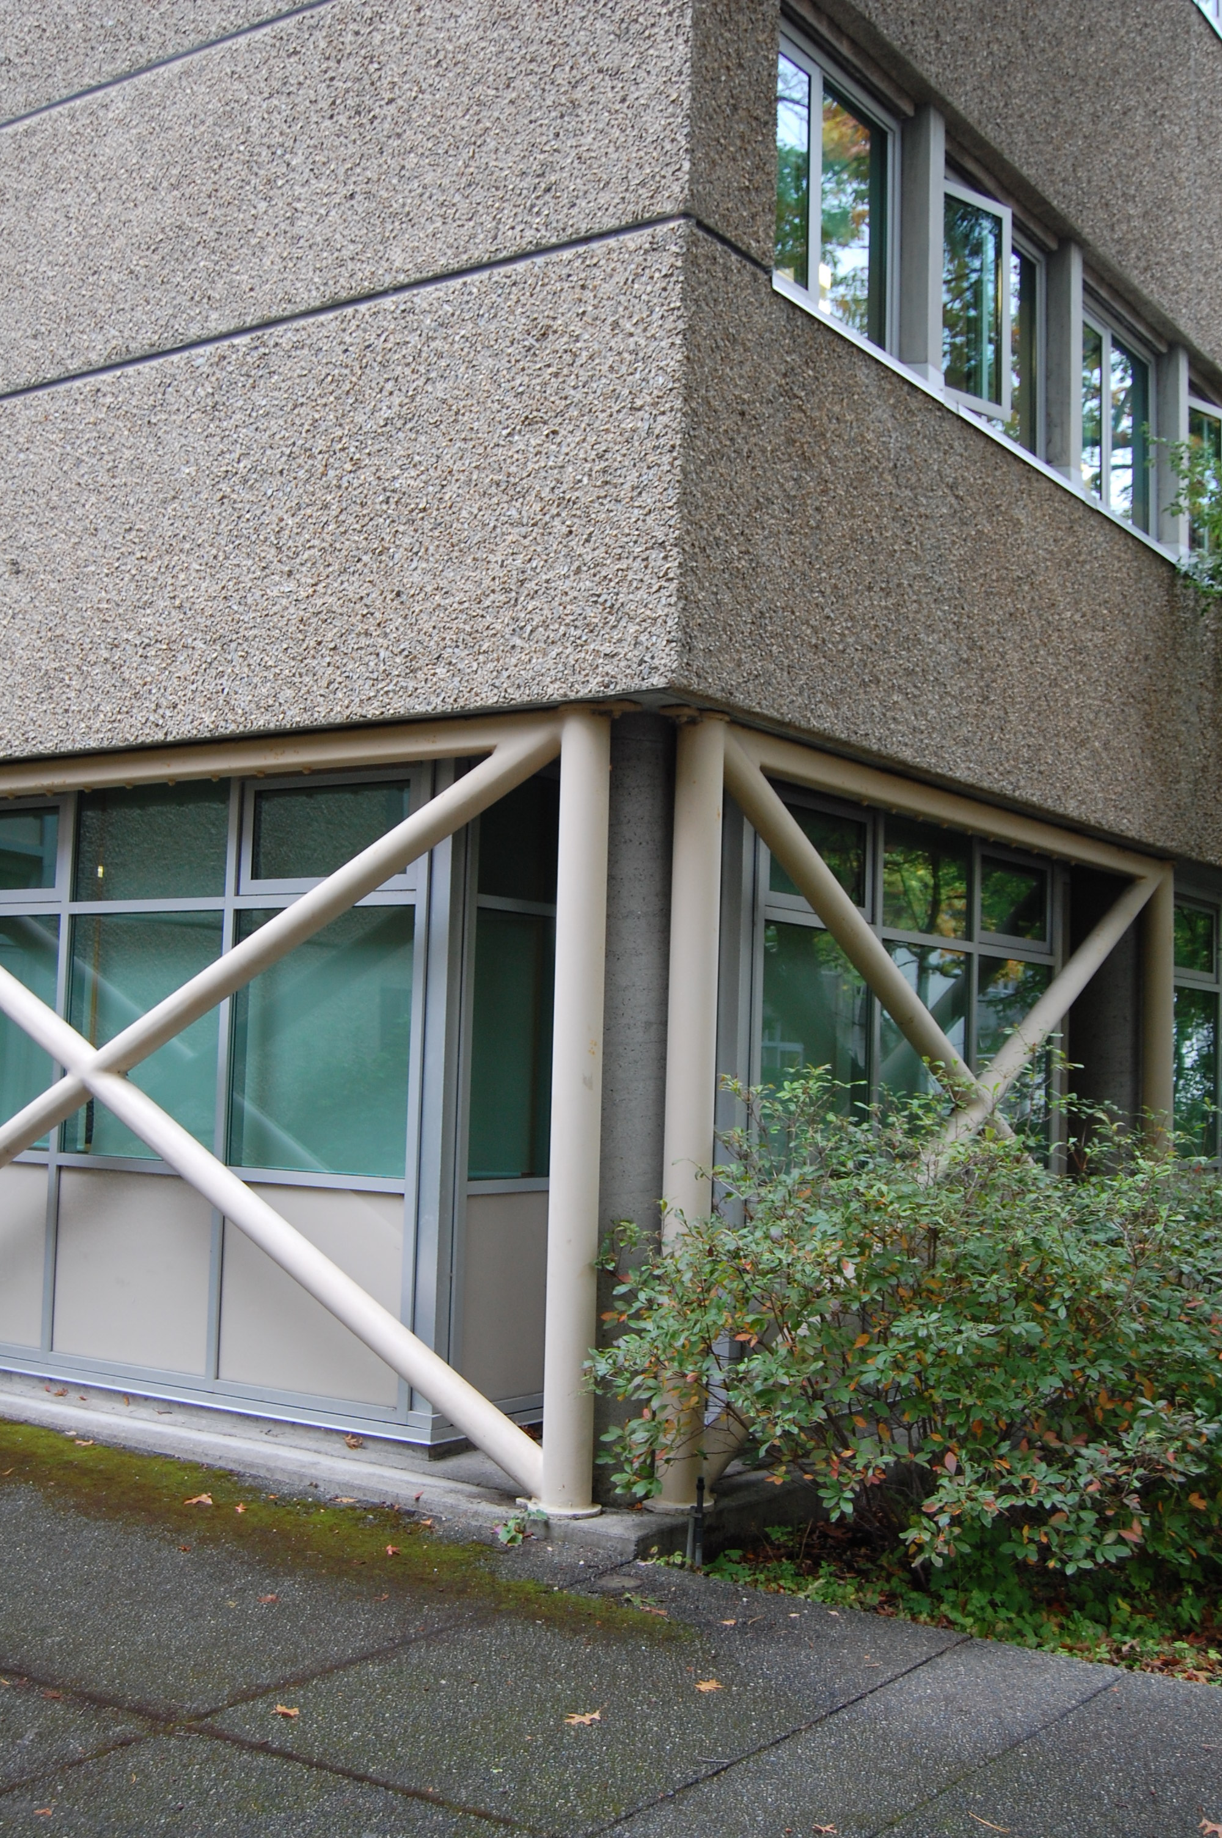
2. Clearihue A Wing
1962
Wade Stockdill & Armour
Three storey reinforced concrete
Exterior exposed concrete
Glazed stairwells with Mobile sculptures by Victoria artist William West
Pilotis ground floor open to nature
Later renos resulted in stucco cladding, shopfront glazing and Hollow Steel Sections for seismic mitigation

Slide 7
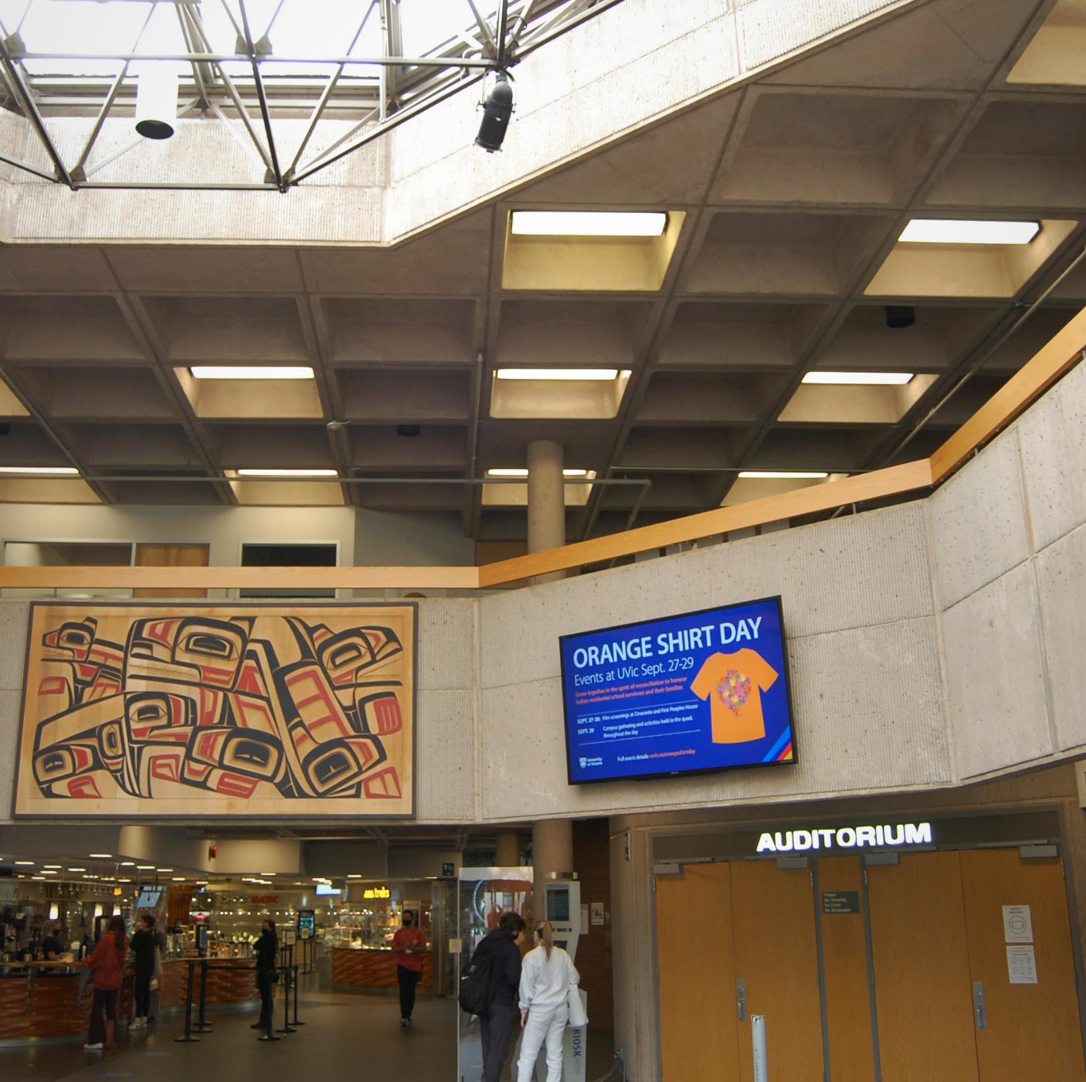
3. Jammie Cassels Centre
University Centre 1977 & Auditorium 1978
Wade Williams Architects
2 storey reinforced concrete
Reeded & chiseled concrete finish
Waffle slab concrete (two-way joist slab)
Le Corbu influence (Ronchamp chapel) natural light, acoustic effect

Slide 8
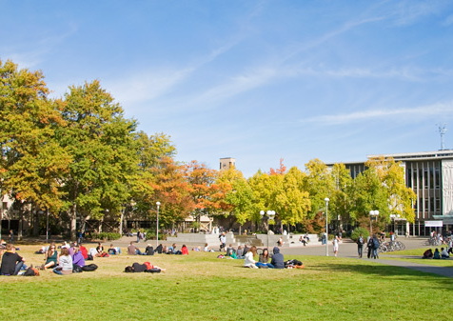
Campus Quad
Campus lands acquired from Hudson Bay Company (forested) and Army Camp (cleared)
Quad is bisected diagonally North/East cleared and South/West edge forested
Architectural debate International Rationalists Bauhaus/ Le Corbu mechanistic architecture & formal expression of materials (Wade, Hodgson, Sidall, Wagg)
Romantic Traditionalists FLW, Bruce Goff inspired by site, local craft, design tradition (Di Castri, Downs, Marshall, Lester)

Slide 9
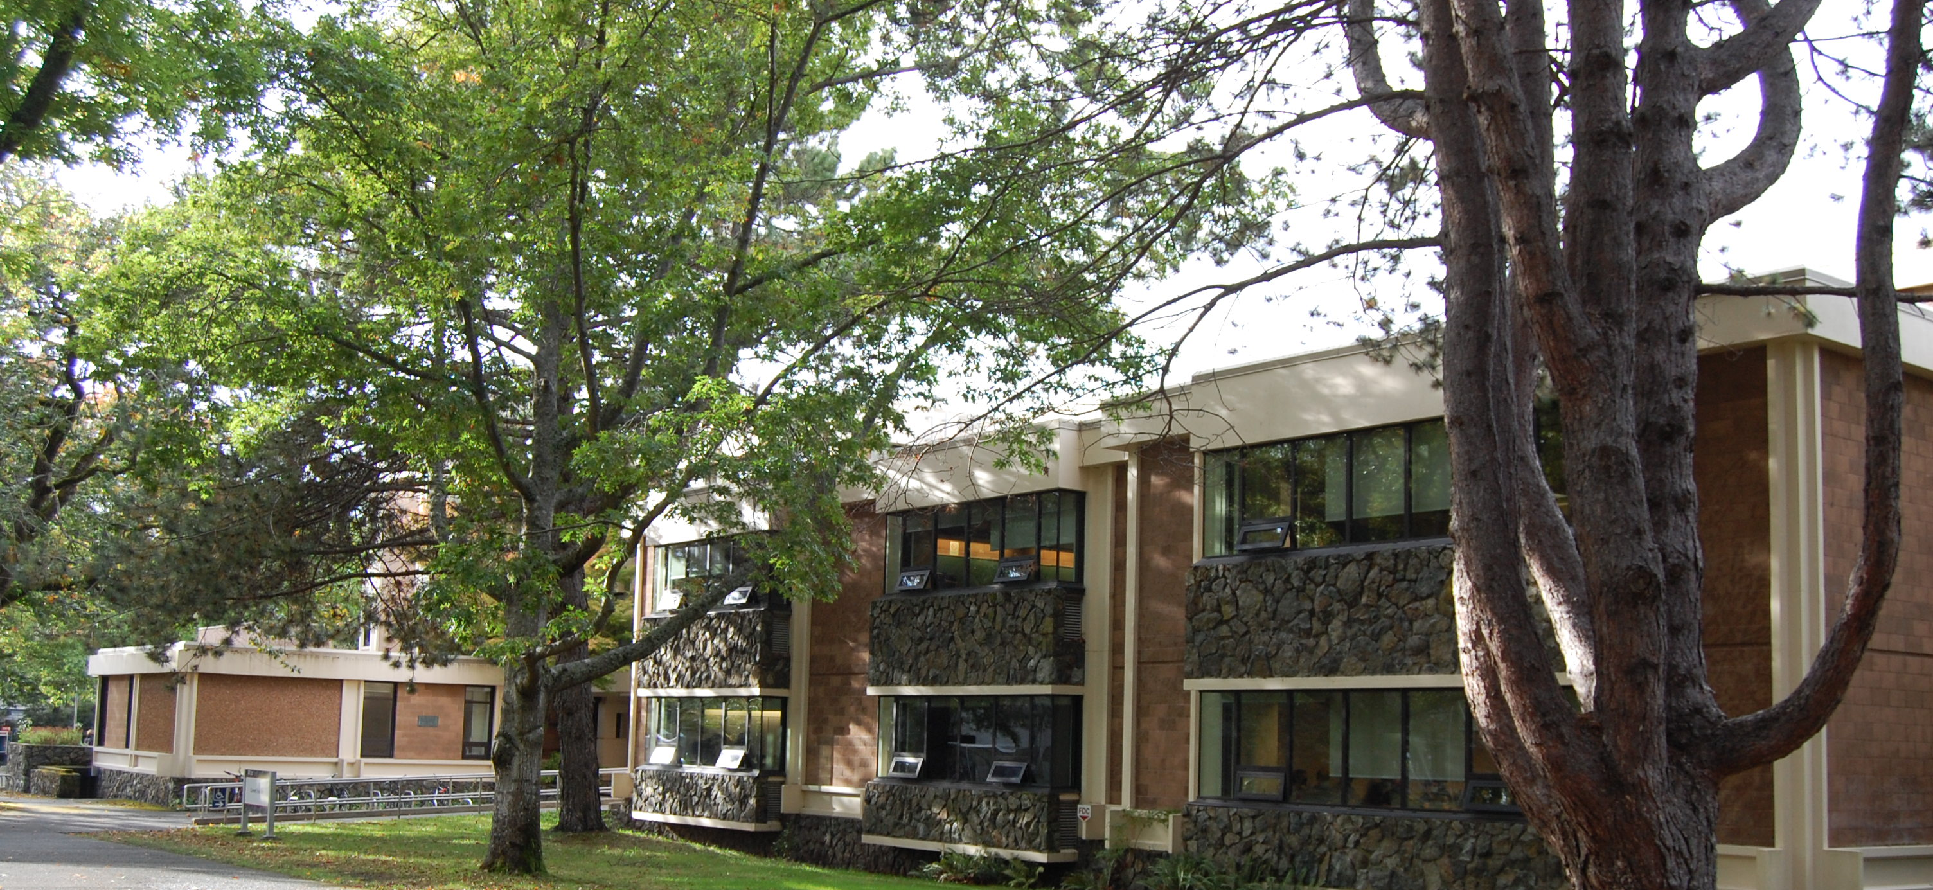
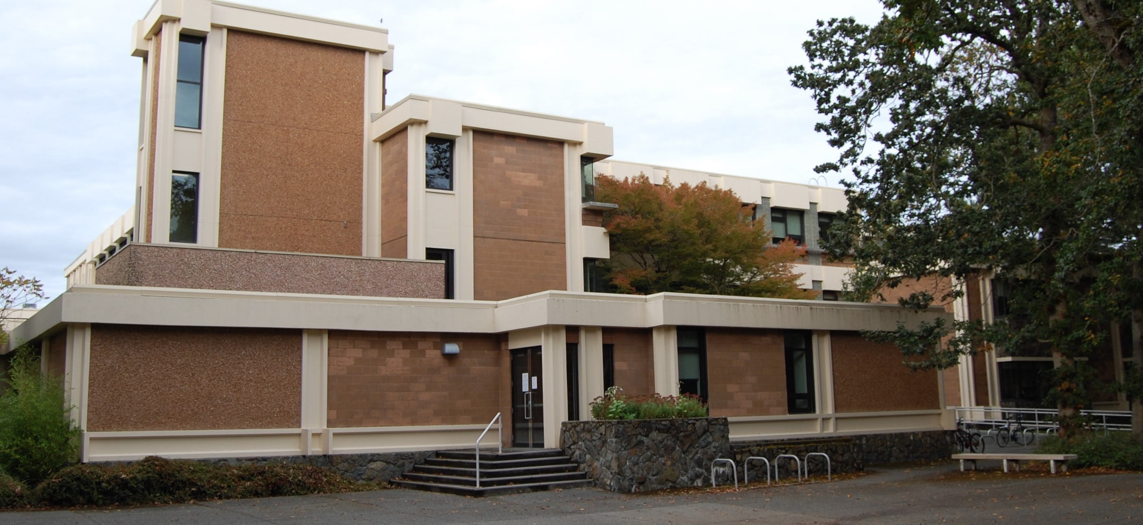
4. Cornett Building
1966
John Di Castri
3 storey reinforced concrete
Rich pallet of exterior materials: shale aggregate block, marble-type stucco, rubbed concrete beams & columns, local metamorphic rock
Complex planning to separate 4 academic departments
19th Century West Coast Organic, Arts & Crafts contrast to the International Style

Slide 10
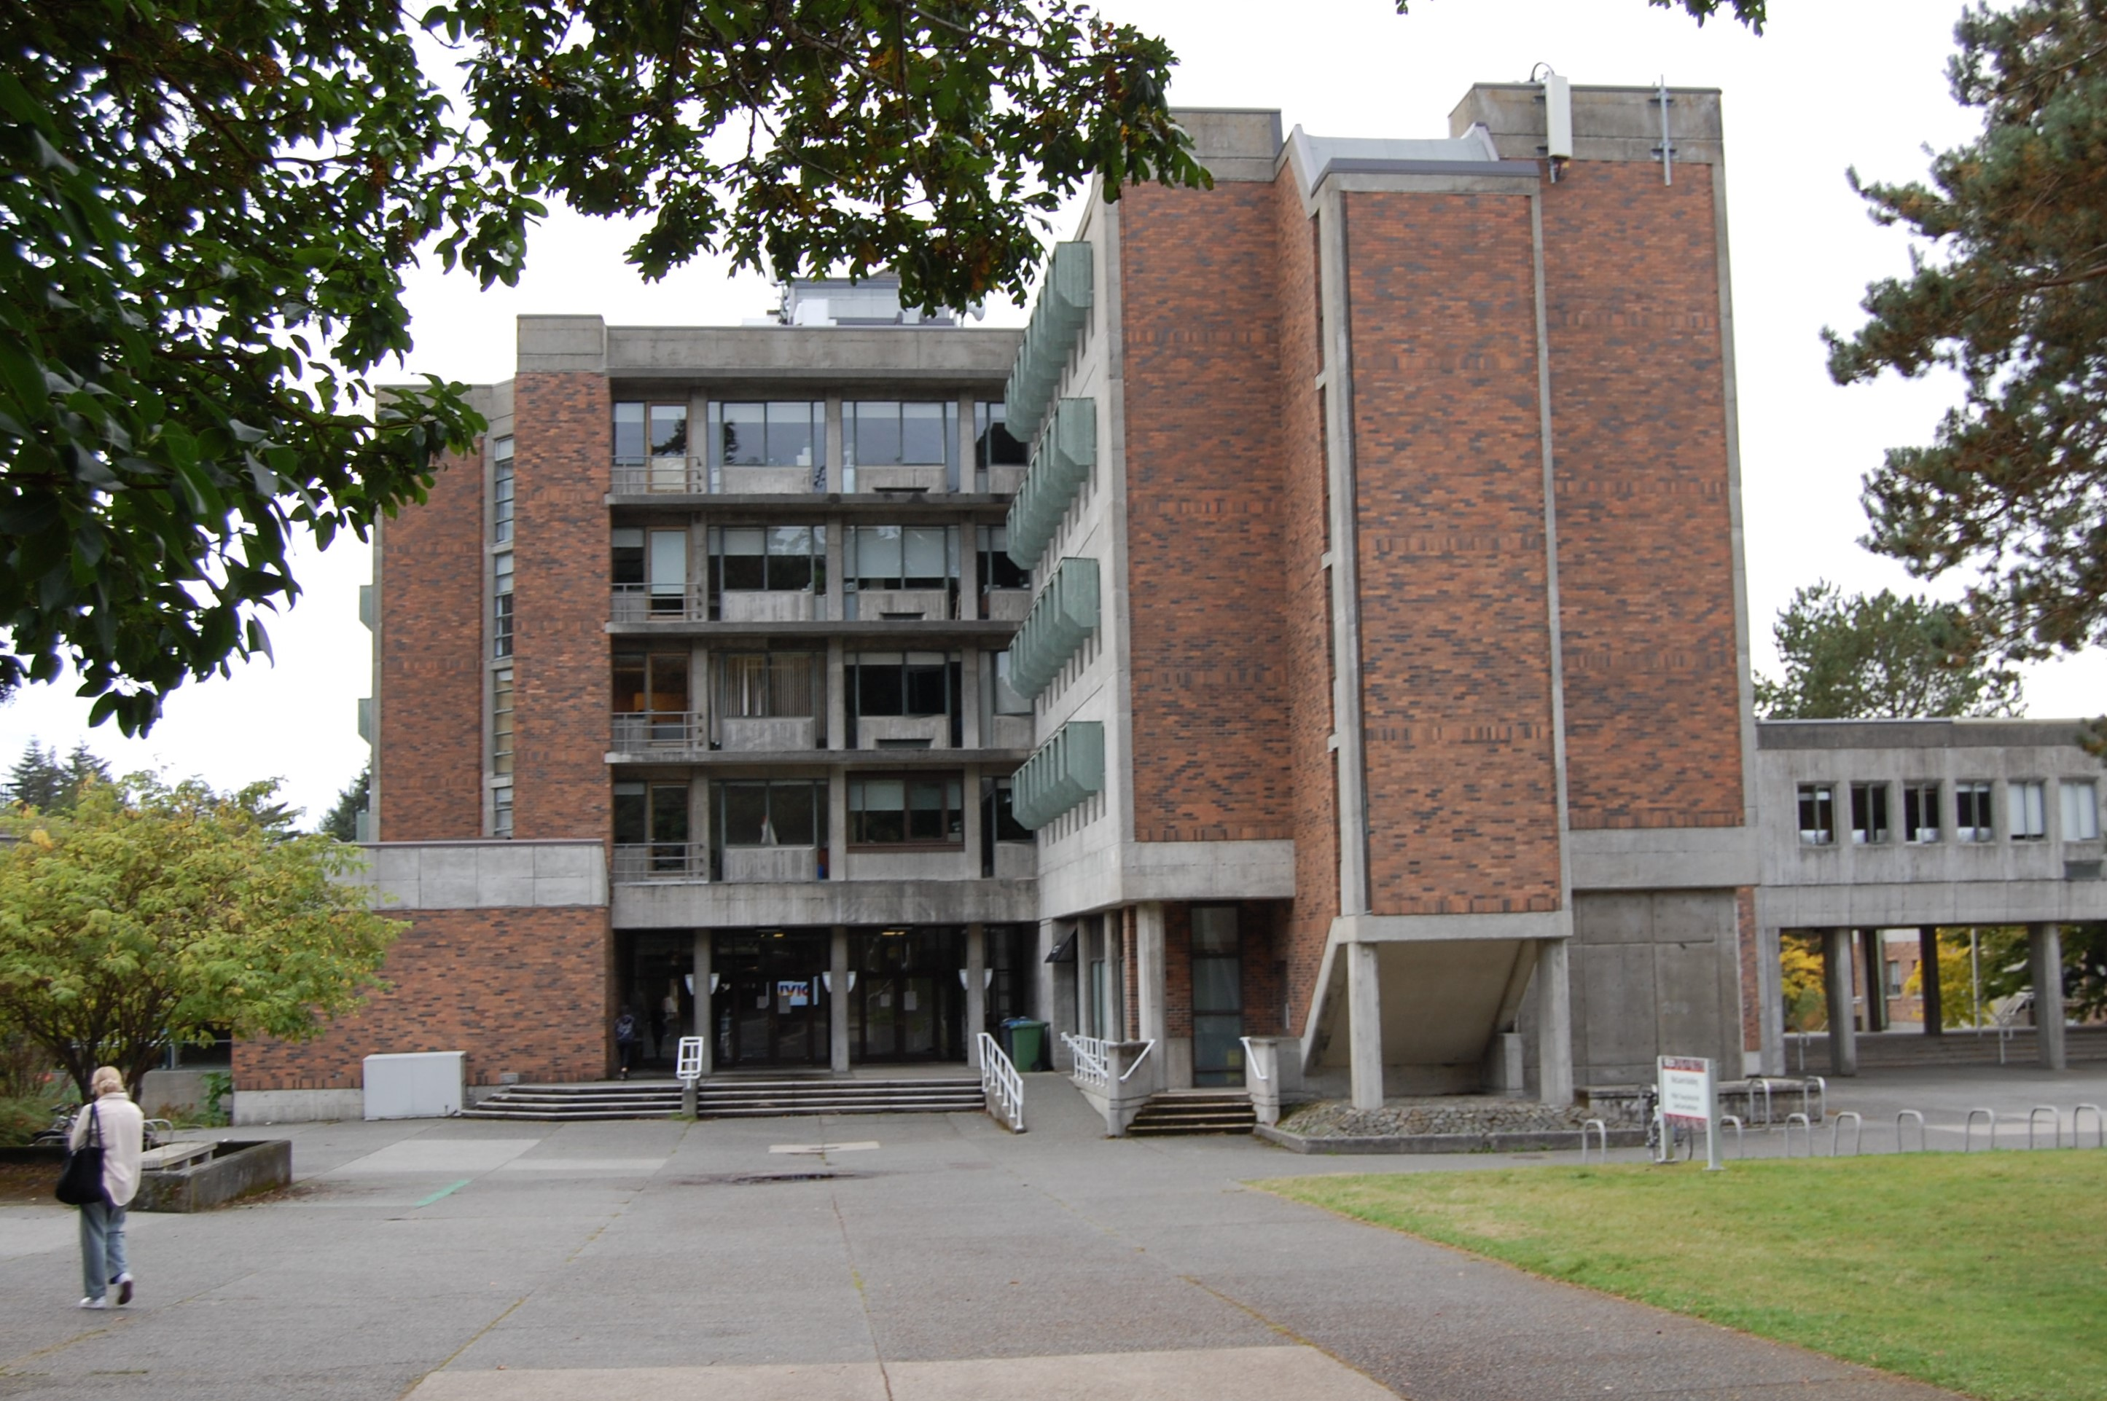
5. MacLaurin Building
1966
Alan J. Hodgson
5 storey reinforced concrete
Brick panels reinforce and soften the rigid geometry of the cast concrete
Pillared gallery opening main level to naturalized landscape of the Western edge of the Quad
Hooded window shades
Ribbon Windows

Slide 11
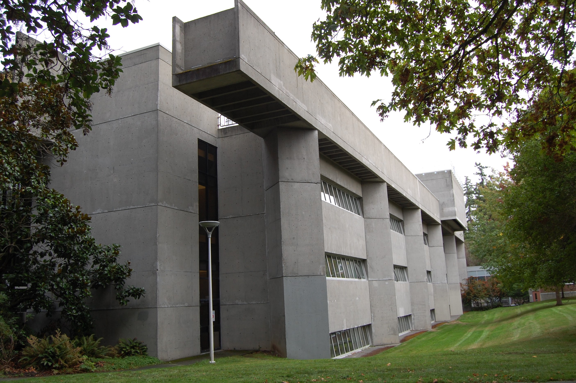
6. Cunningham Building
1971
Arthur Erickson & Geoffrey Massey
3 storey reinforced concrete
Exposed concrete exterior walls
Brutalist Style – abstract, massive, monolithic, rigid geometry
Thrusting elements express function of ventilation system ducts
Erickson 1967/68 Master Plan for the Campus rejected

Slide 12
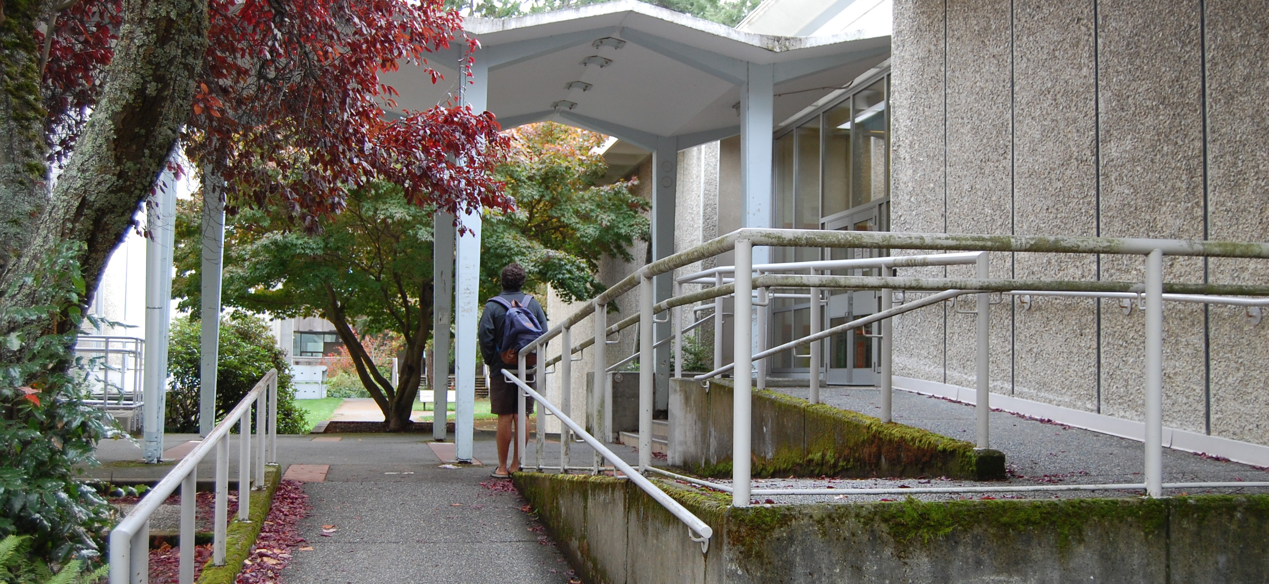
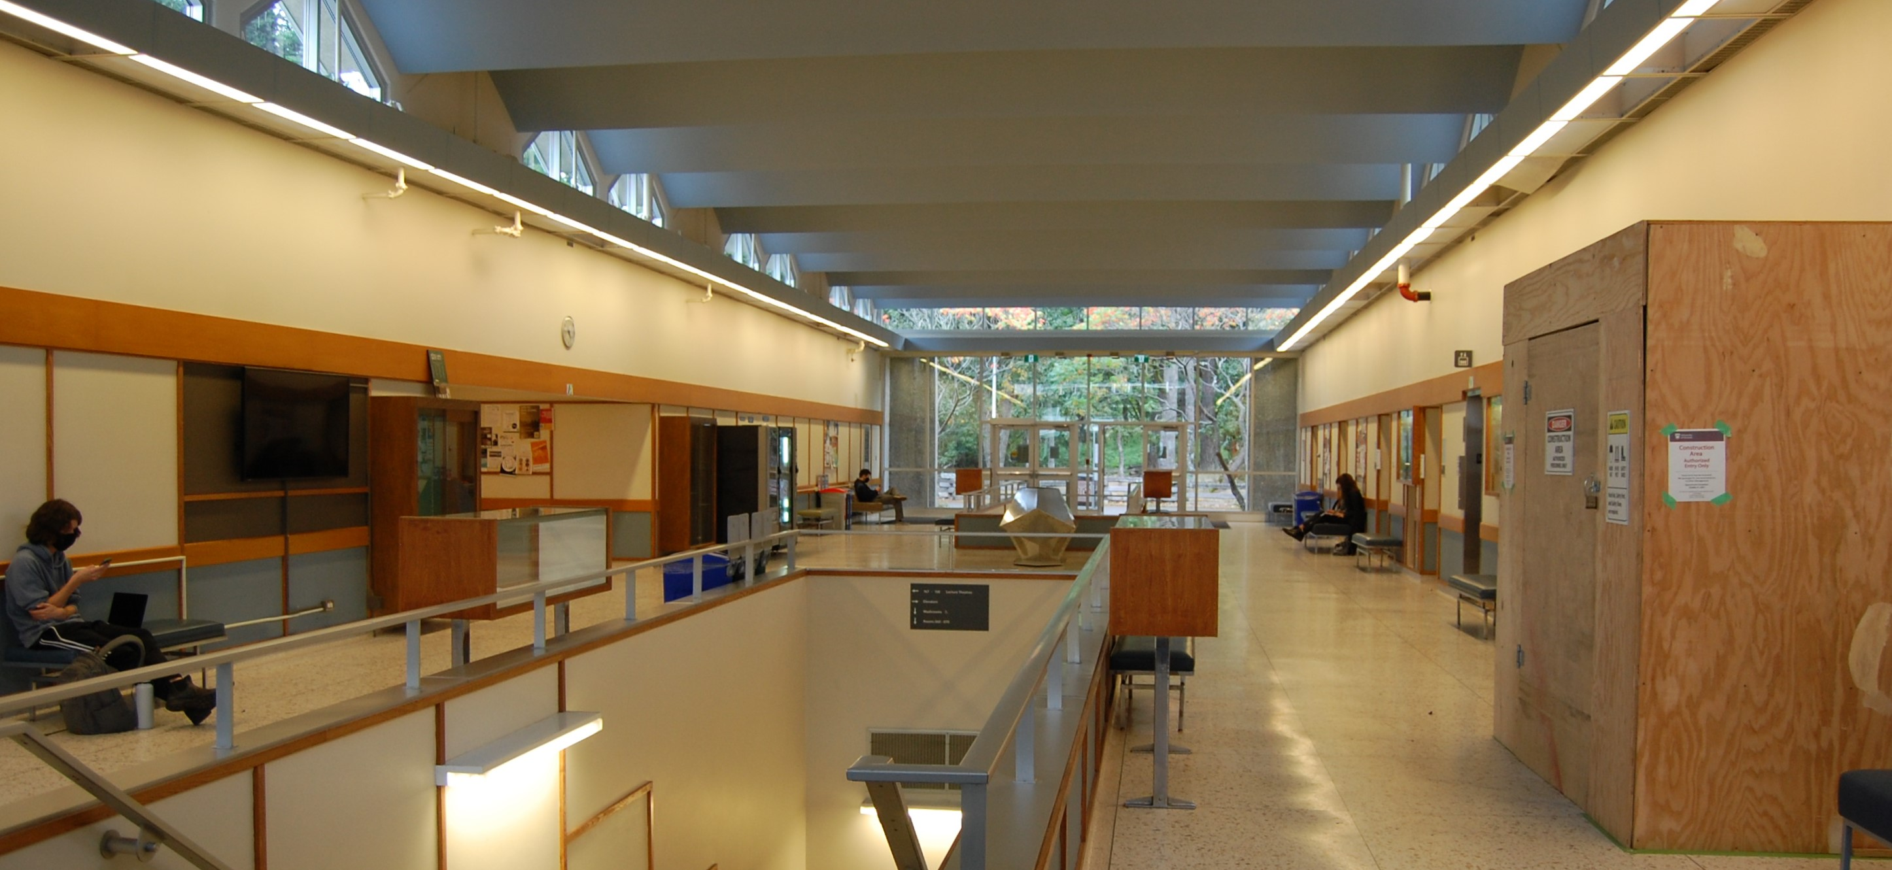
7. Elliott Lecture Theatre
1964
Wade Stockdill & Armour
One storey reinforced concrete
Folded concrete plate roof
Clerestory windows provided by roof structure to main circulation hall.
Entrance canopy expresses the building structure

Slide 13
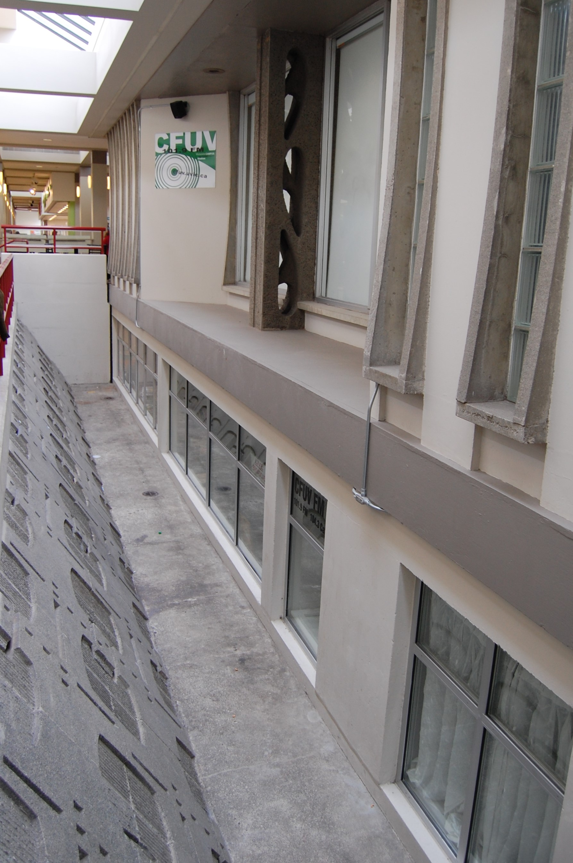
Optional Tour 8. Student Union Building
1963
John A. Di Castri
Reinforced concrete, brick masonry, stucco
One storey
Patterned concrete wall opens natural light to basement level
Concrete columns with leaf shaped openings
Sgraffito mural by Victoria artist Herbert Siebner
Original design compromised by 1995 addition

Slide 14
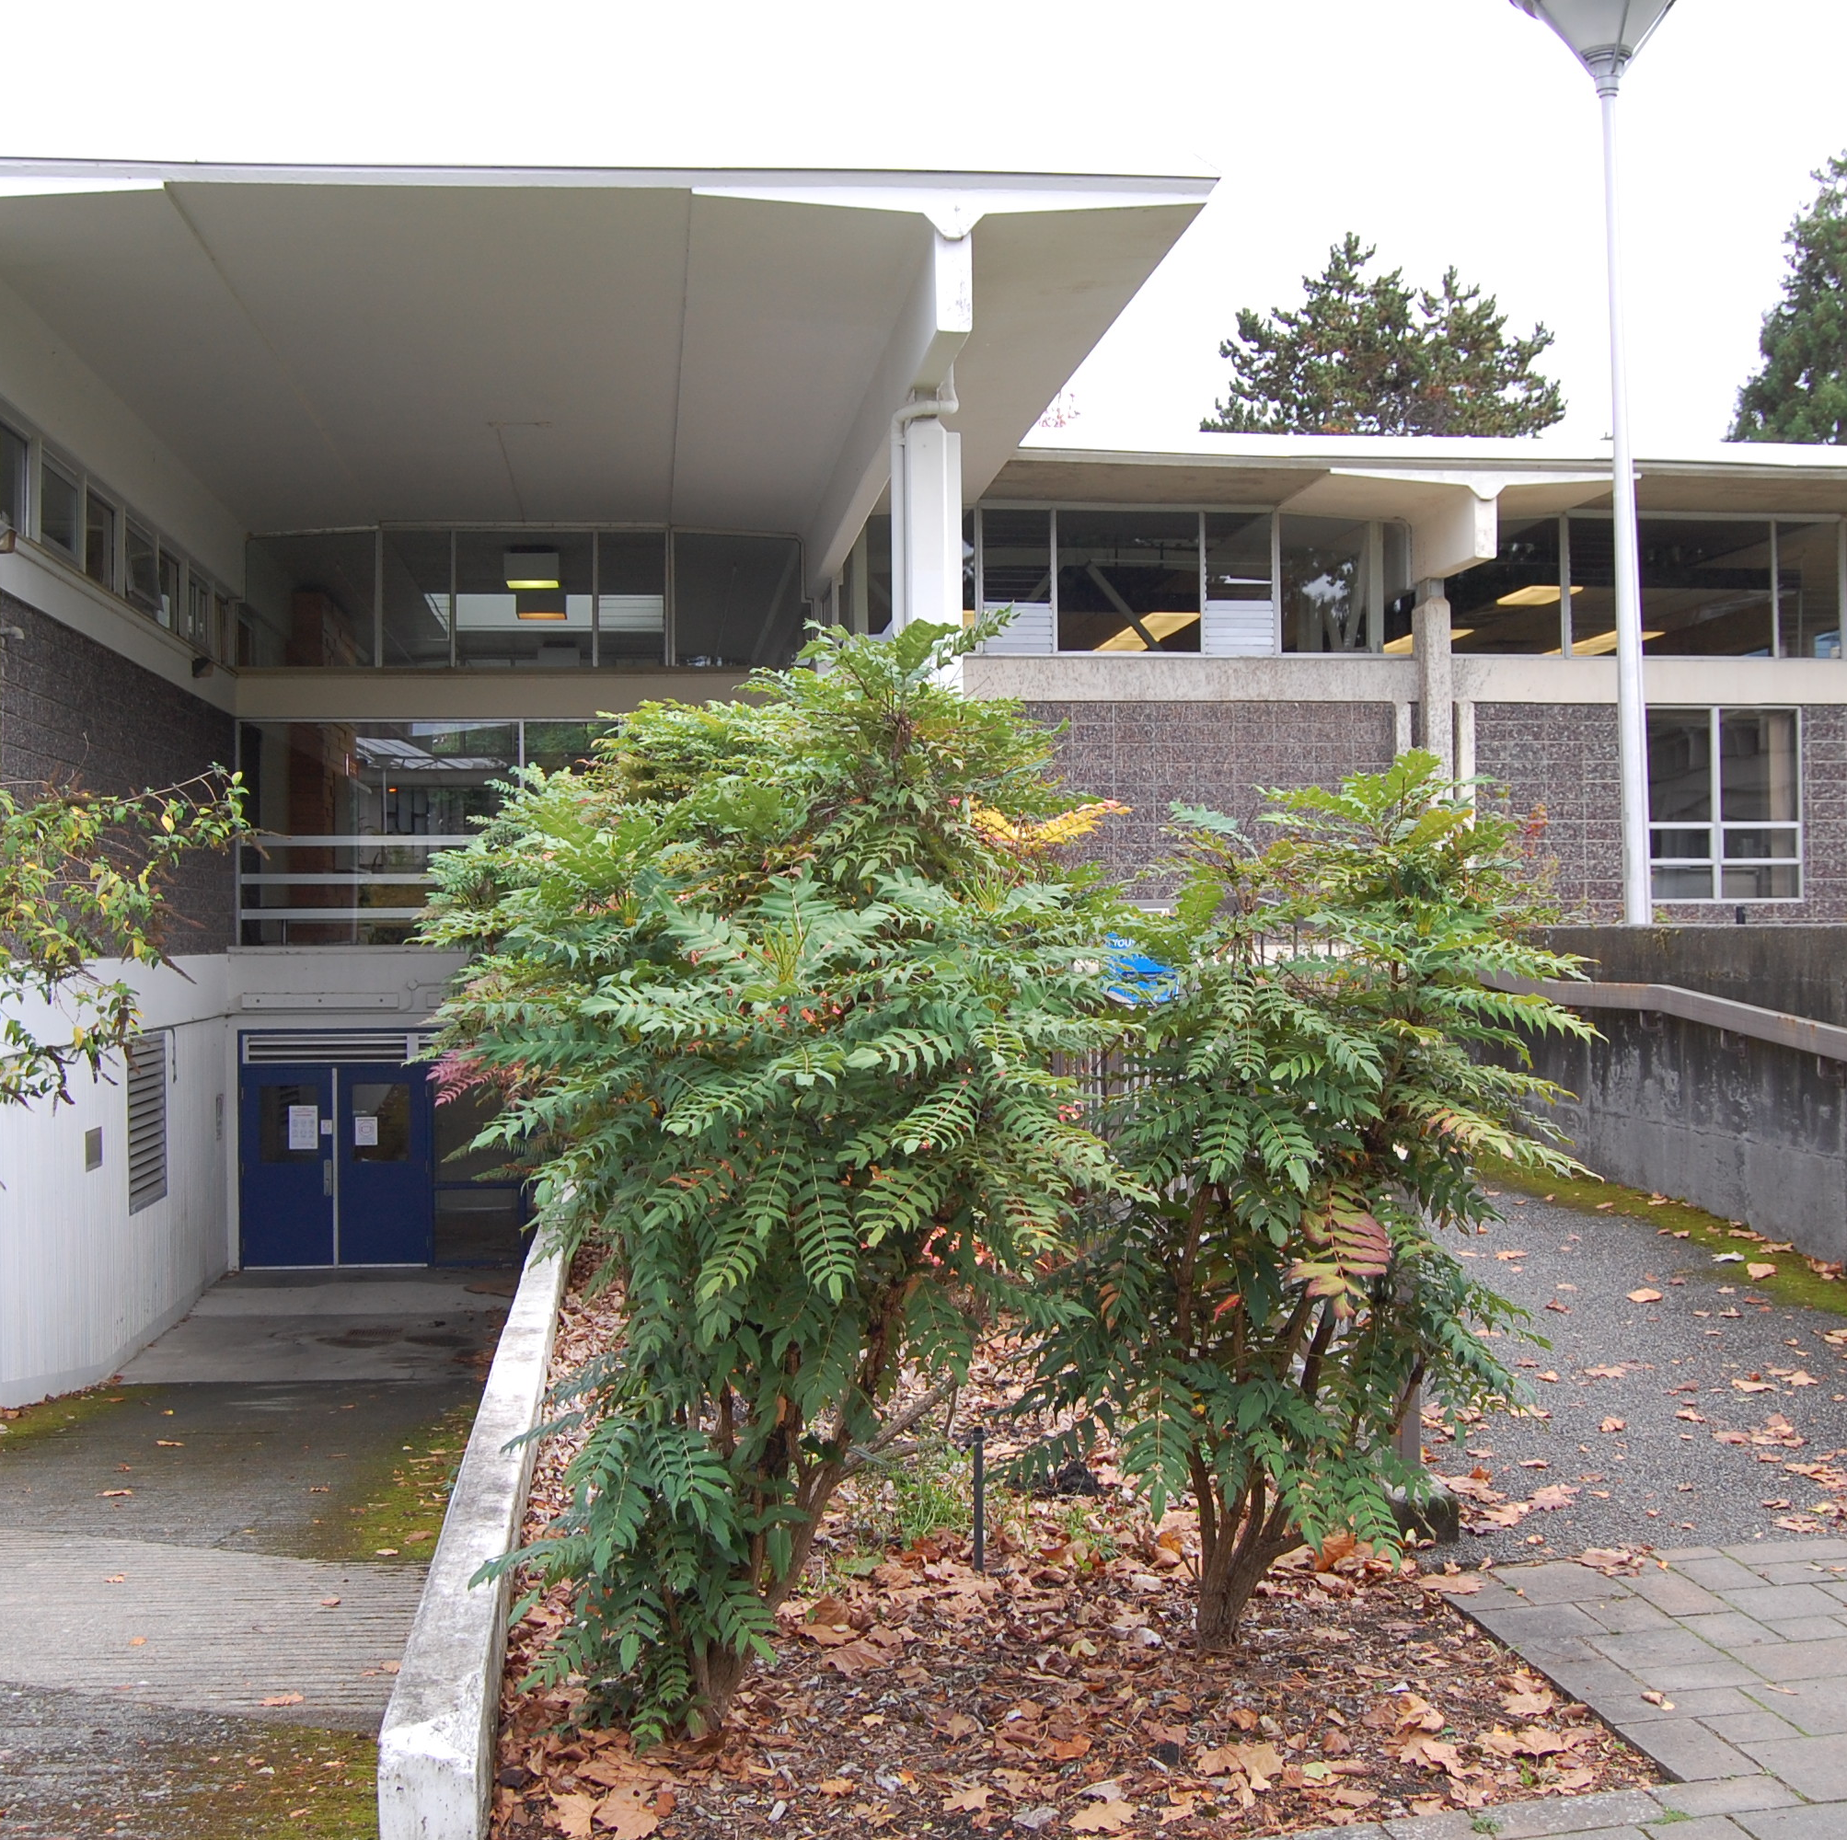
Optional tour 9. Campus Services Building
1965
Donald Wagg
2 storey reinforced concrete with masonry walls
Dominate structural grid
Roof - massive pre-stressed concrete T beams “Floats” above strip clerestory windows

Slide 15
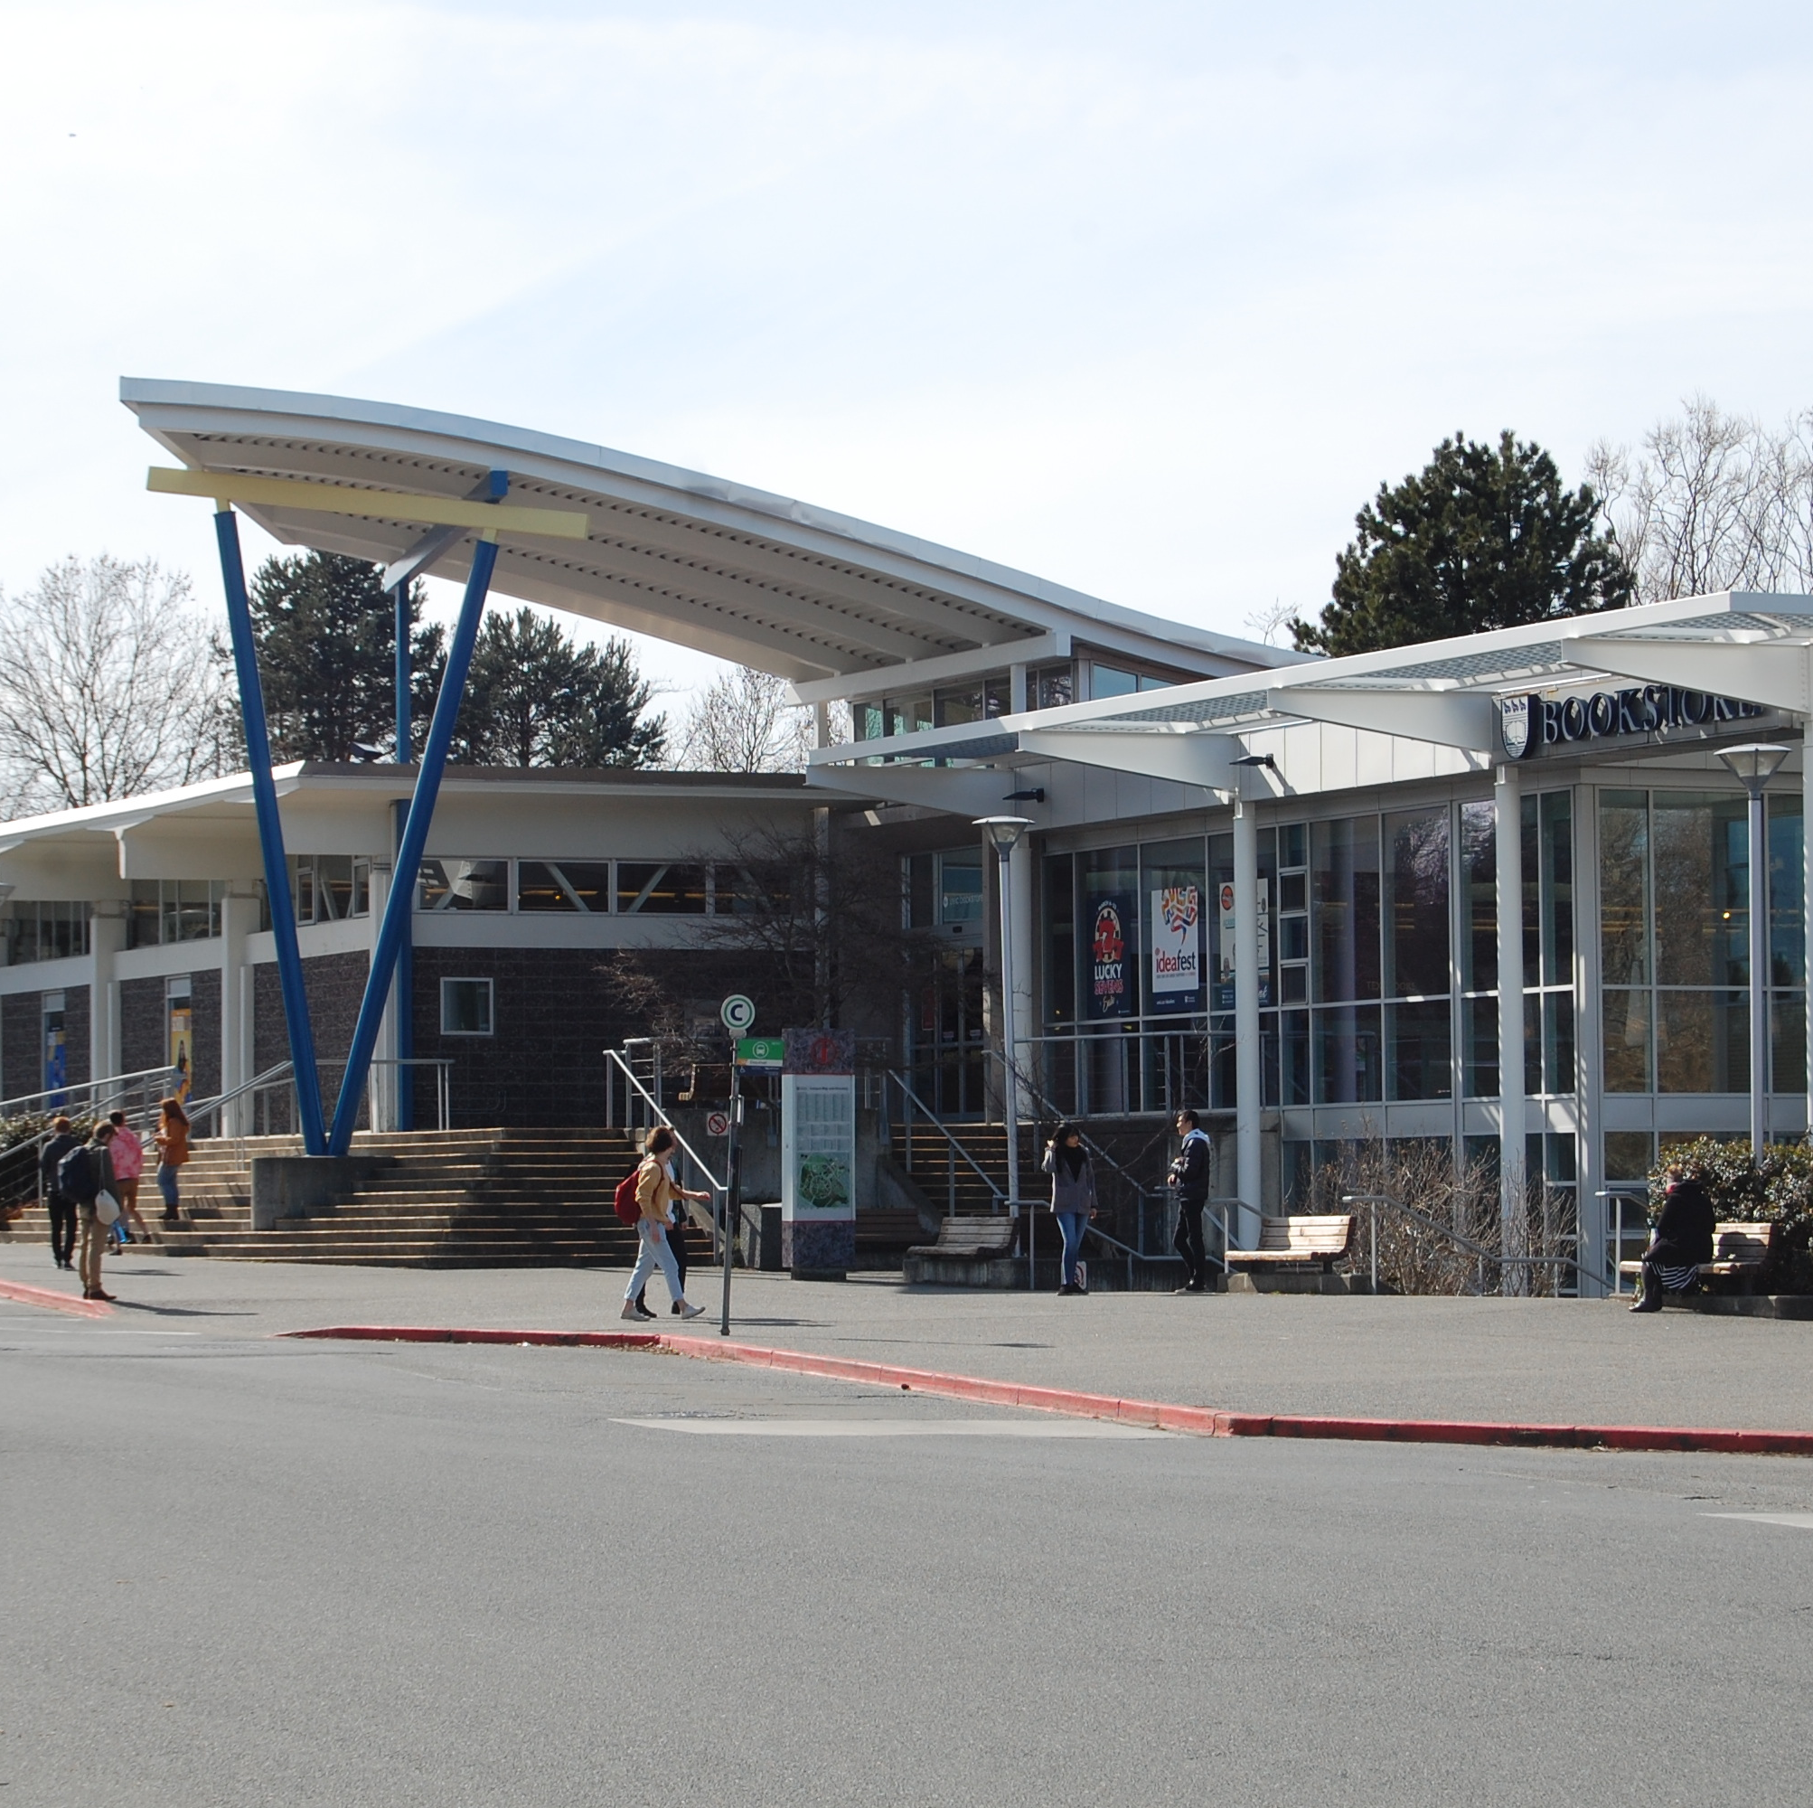
Optional tour 9. Campus Services Building Addition
1995
Jensen Group Architecture
Modern rationalist design
Extends geometry
Modular steel components
glass curtain wall
perforated sunscreen
pleasing addition to the original design vocabulary

